Slide 1
Library Management System App
By Kishore Bhosley

Slide 2
What is this app about?
In this app, Librarian can -
View and remove users
View, add, remove & update books.
Librarian can set library location and range
Students and Faculties can login in to the app only if they are within the specified range.
Students and Faculties can issue book by logging in.

Slide 3
Technologies used in this app
SQLite Database – to store data locally.
Circular Encryption / Decryption – to encrypt emails and passwords.
FusedLocationProviderClient – to get user’s latitude & longitude.
Geocoder – to get address from latitude & longitude.
Custom and in-built Animations – to enhance user experience.

Slide 4
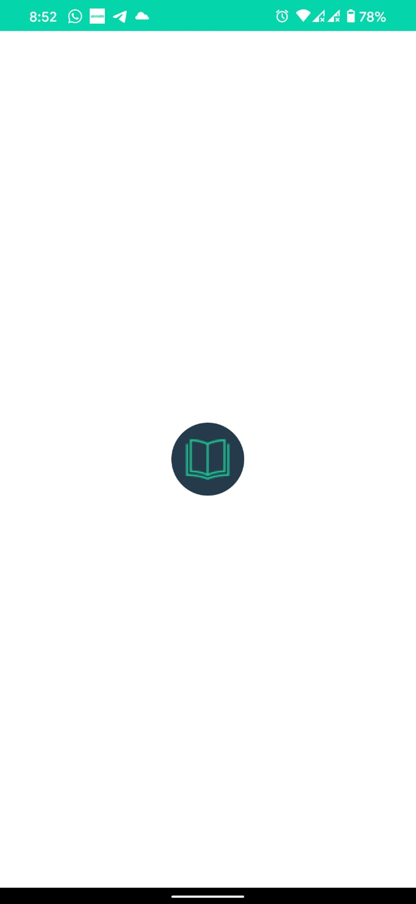
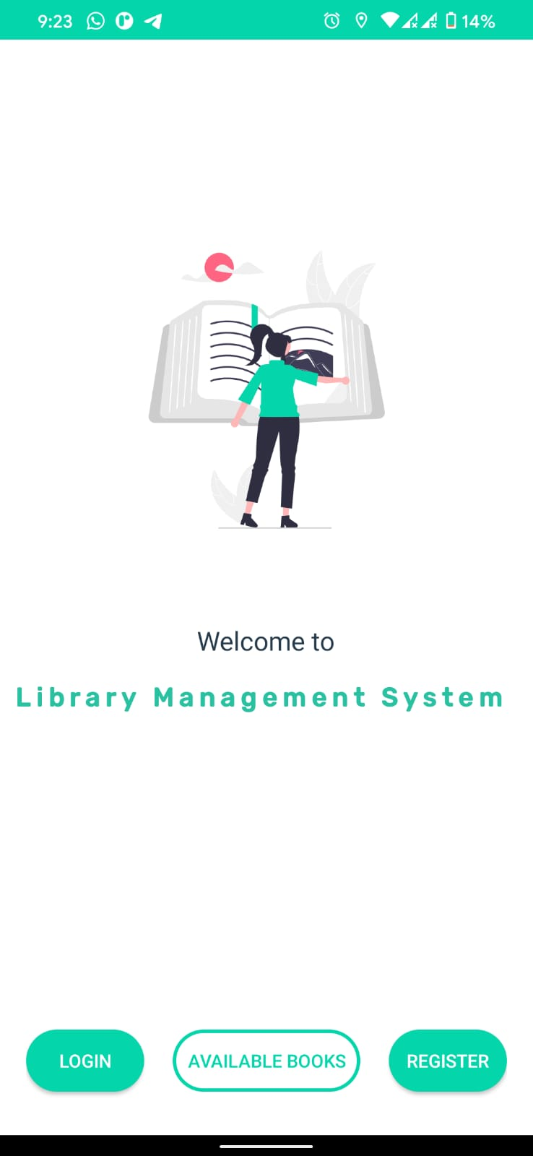
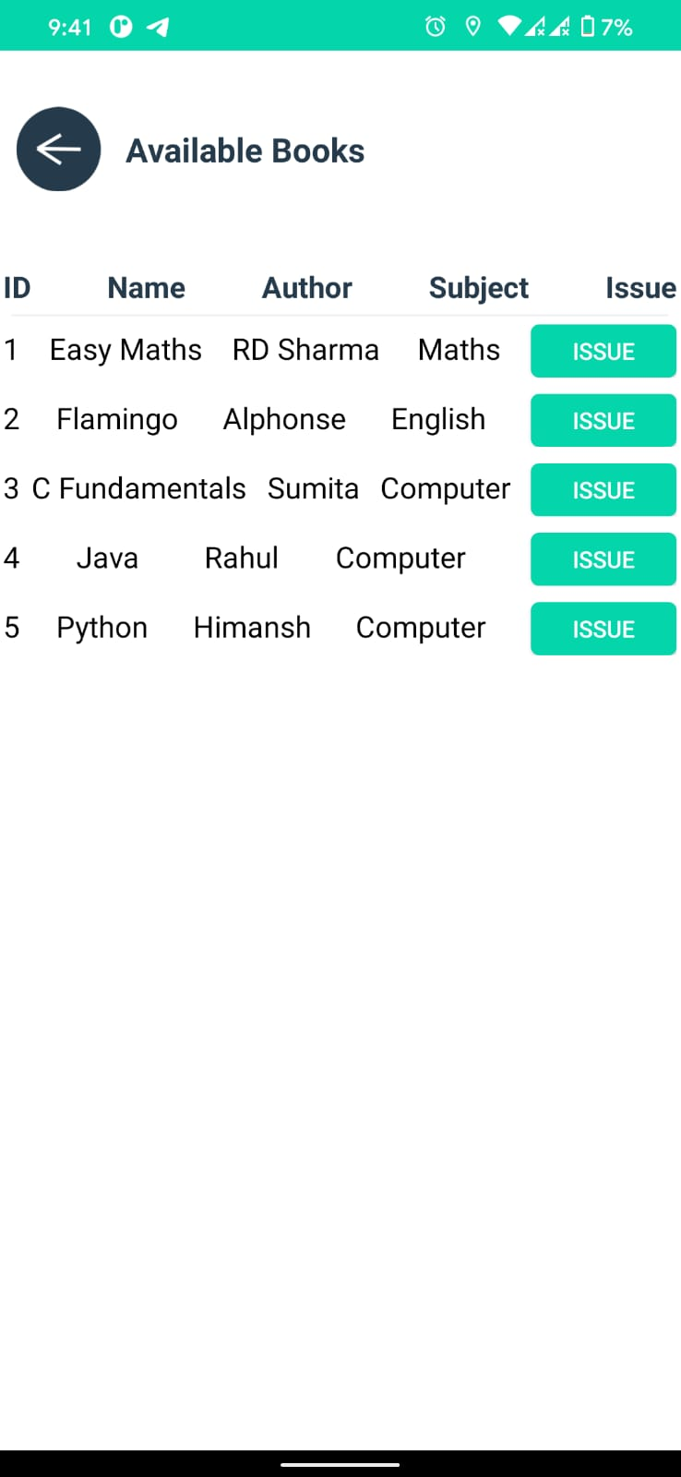
App Screenshots
Splash Screen
Welcome Screen
User can check available books without logging in.

Slide 5
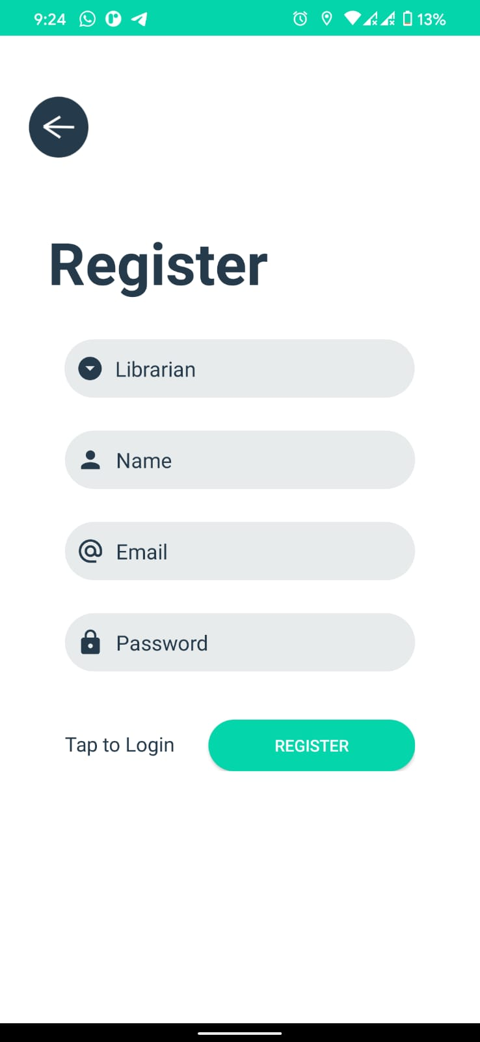
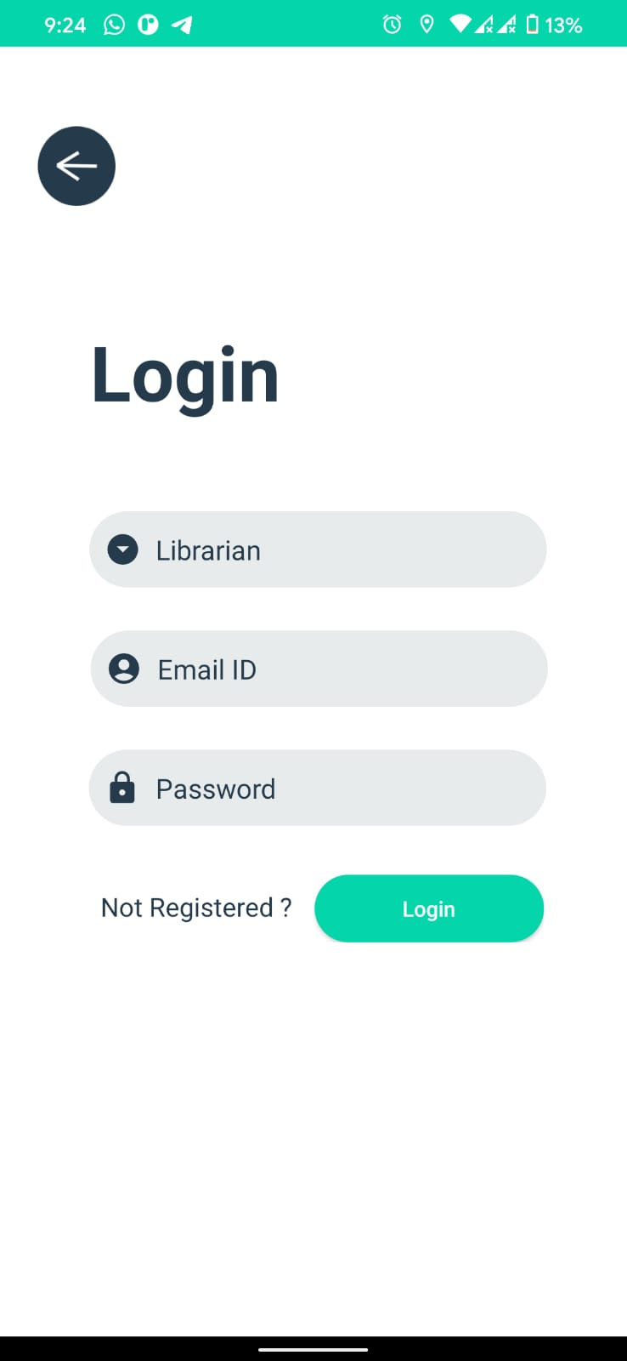
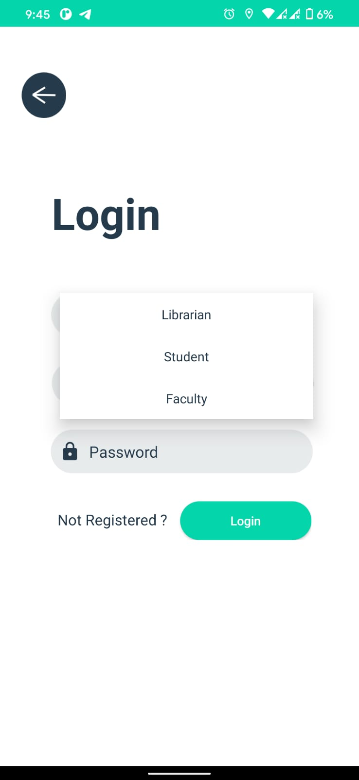
App Screenshots
Register Activity
Login Activity
Types of users

Slide 6
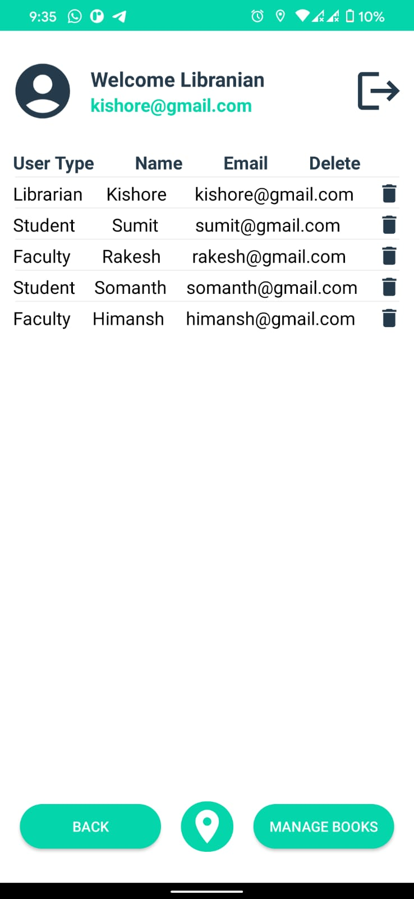
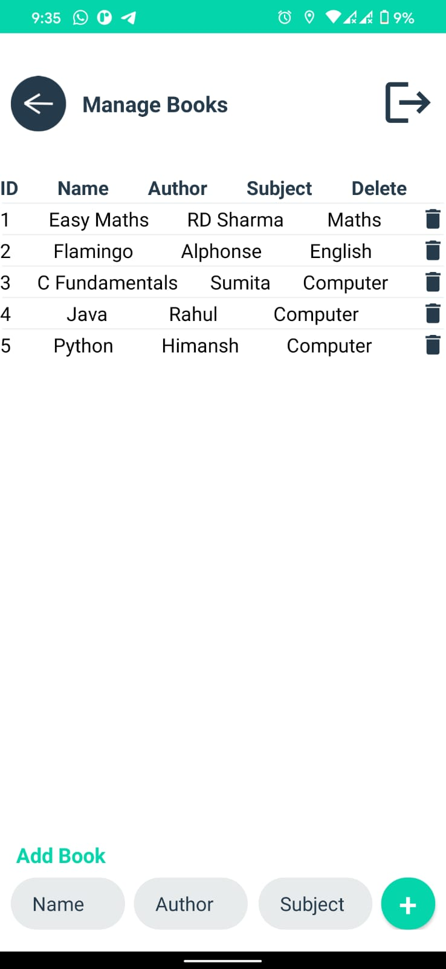
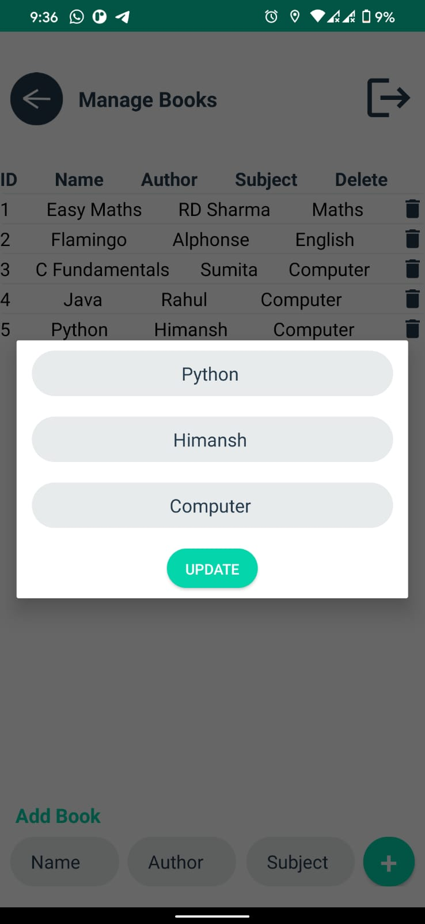
App Screenshots
After logging in as Librarian, Librarian can view & remove users
Librarian can view, add, remove & update books
Update alert dialogue box

Slide 7
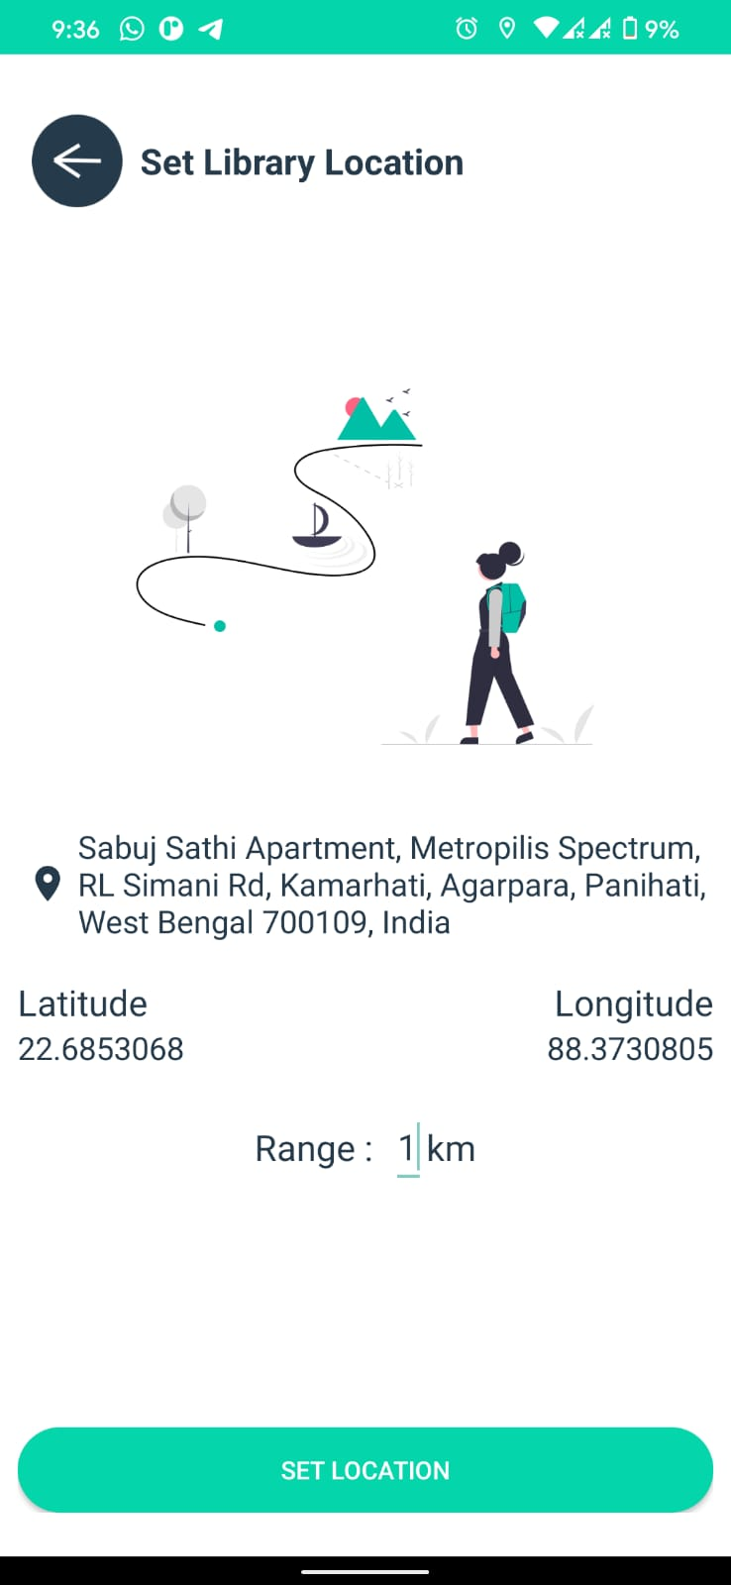
App Screenshots
Librarian can set library location as well as range so that students & faculties can issue book after logging in inside the specified range

Slide 8
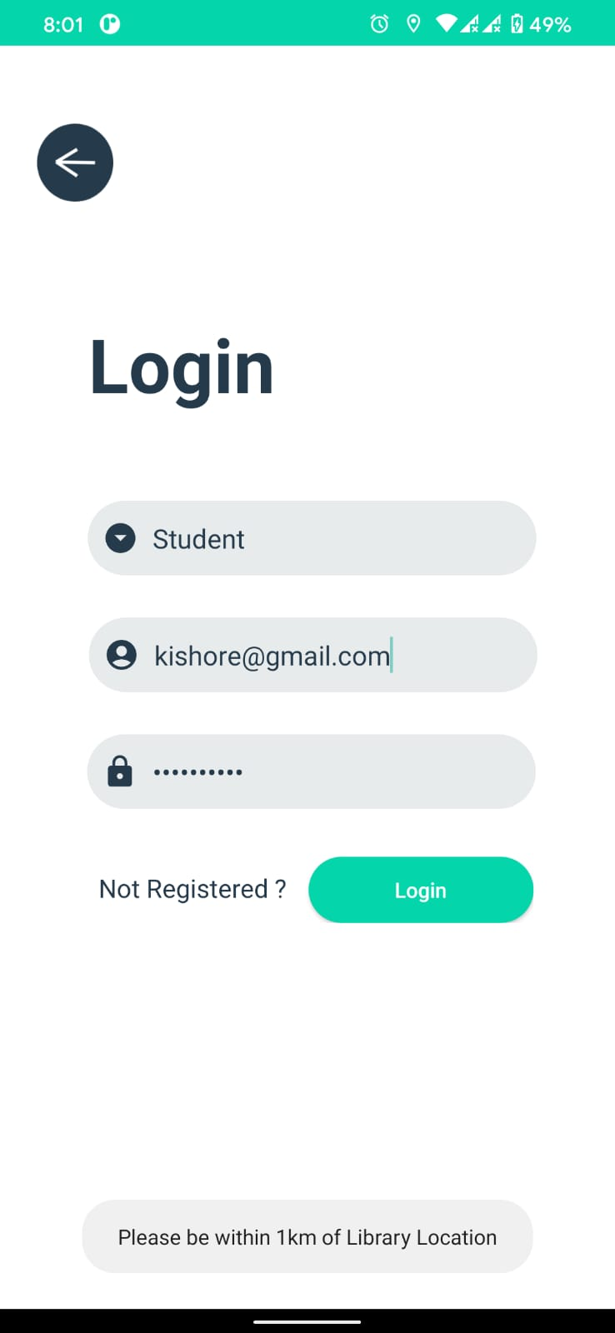
App Screenshots
User won’t be able to sign in if he/she is out of library location range

Slide 9
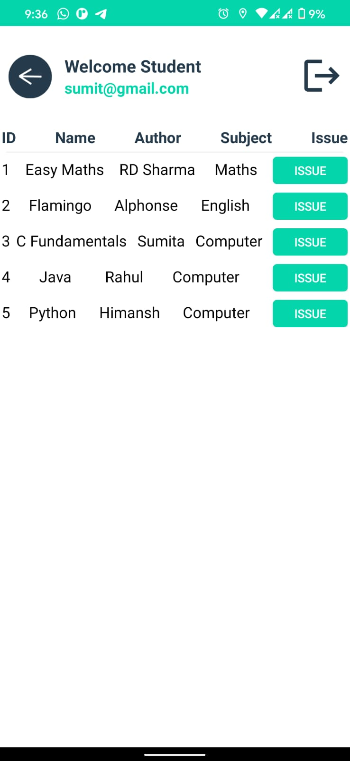
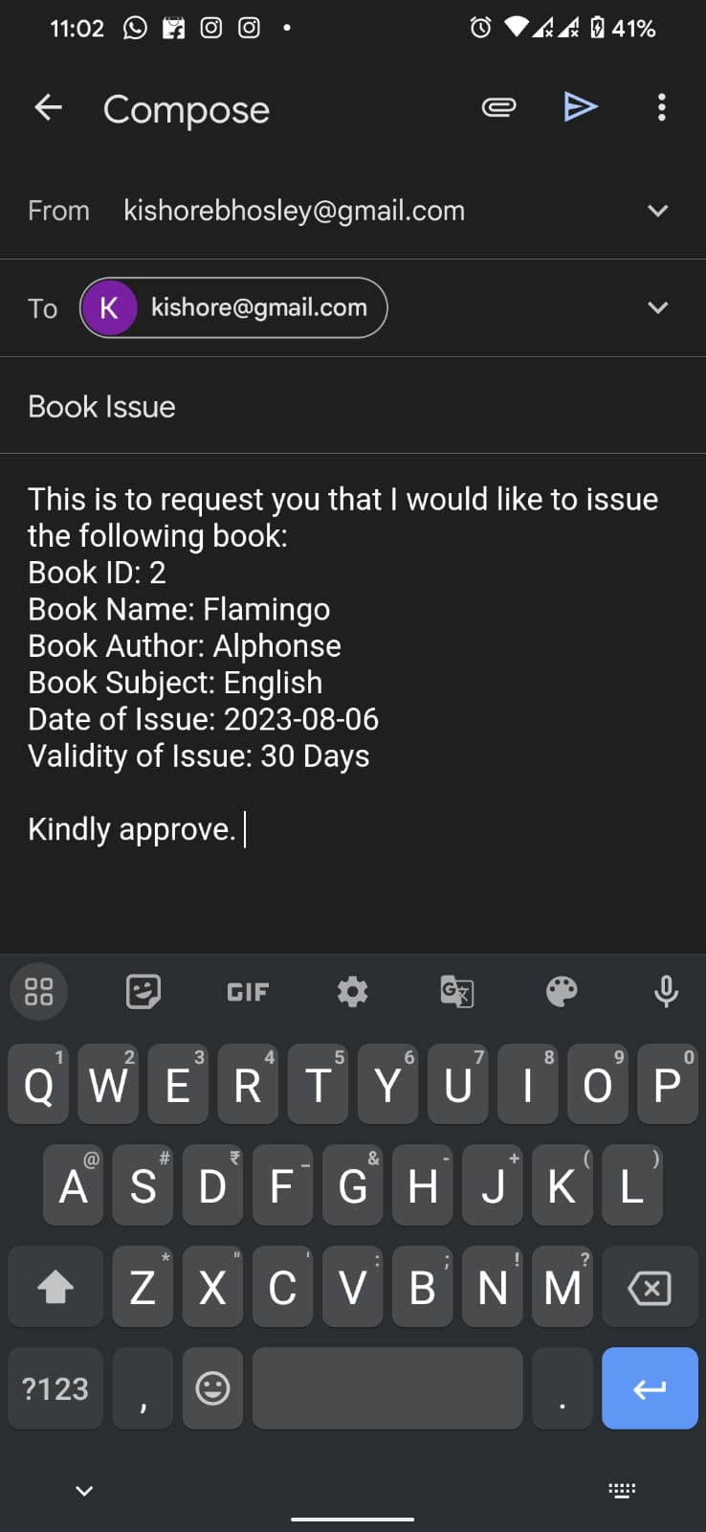
App Screenshots
After logging in as Student, Student can issue book by clicking on the issue button

Slide 10
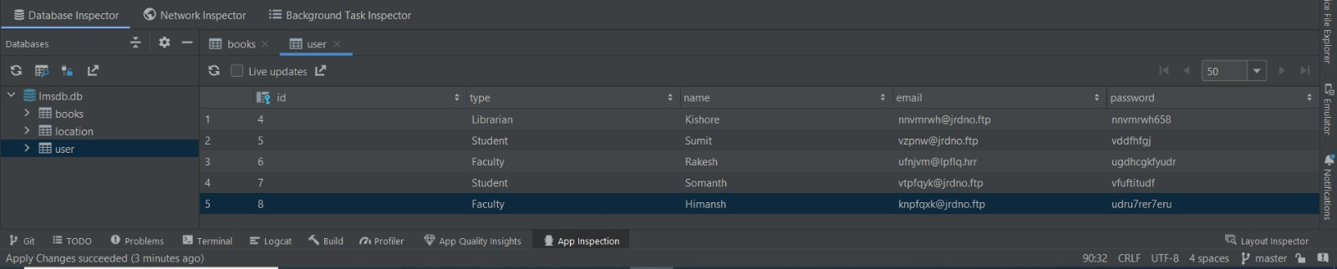
Circular Encryption
All the letters in a String present at Odd positions will be encrypted with key=3 and all the even positioned characters will be encrypted using key= 5.
Space & special characters will not be encrypted.
kishore@gmail.com --> nnvmrwh@jrdno.ftp
Kishore123 --> nnvmrwh658

Slide 11
Demonstration

Slide 12
Things I Learnt During This Internship
Circular Encryption / Decryption
SQL queries to perform CRUD operations
Spinner view
Recycler view
SQLite Database in Android
Animations
Implicit Intent to send e-mail
FusedLocationProviderClient
Volley Library
Git & Github

Slide 13
Thank You

